Slide 1
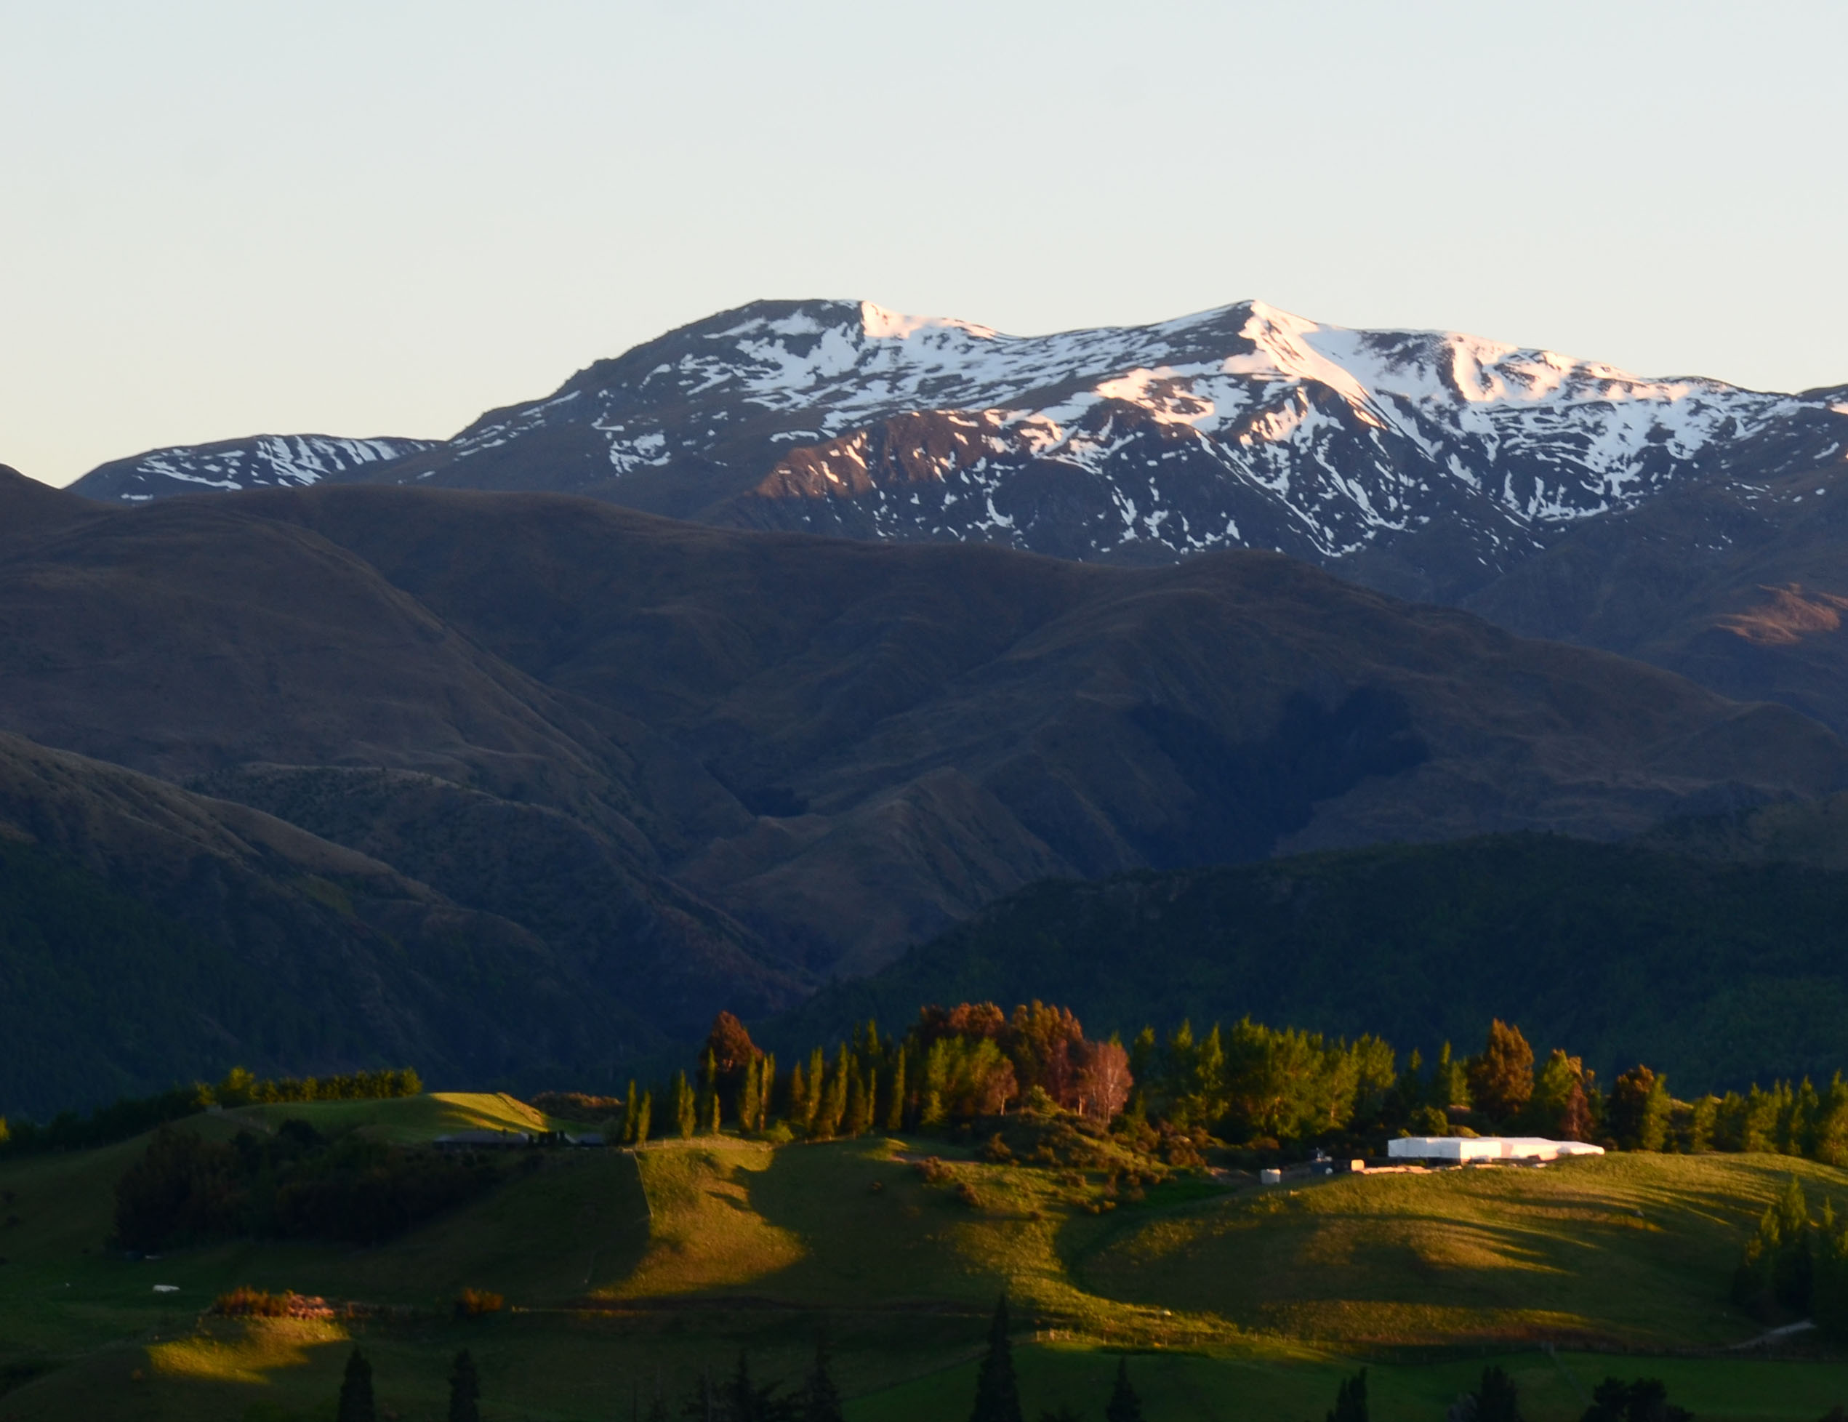

New Zealand
A Travel Presentation Presented by Courtney Berkley
February
2019

Slide 2
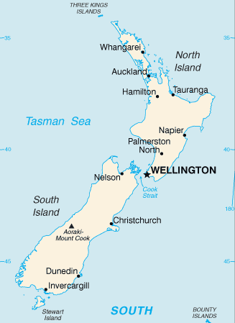
Geography
Located in the South Pacific Ocean
(southeast of Australia)
Consists of 2 main islands
About the size of Colorado
Predominately mountainous with large coastal plains
Lies along the Ring of Fire
Almost 90% of population resides in cities
No natural predators, some have been introduced

Slide 3
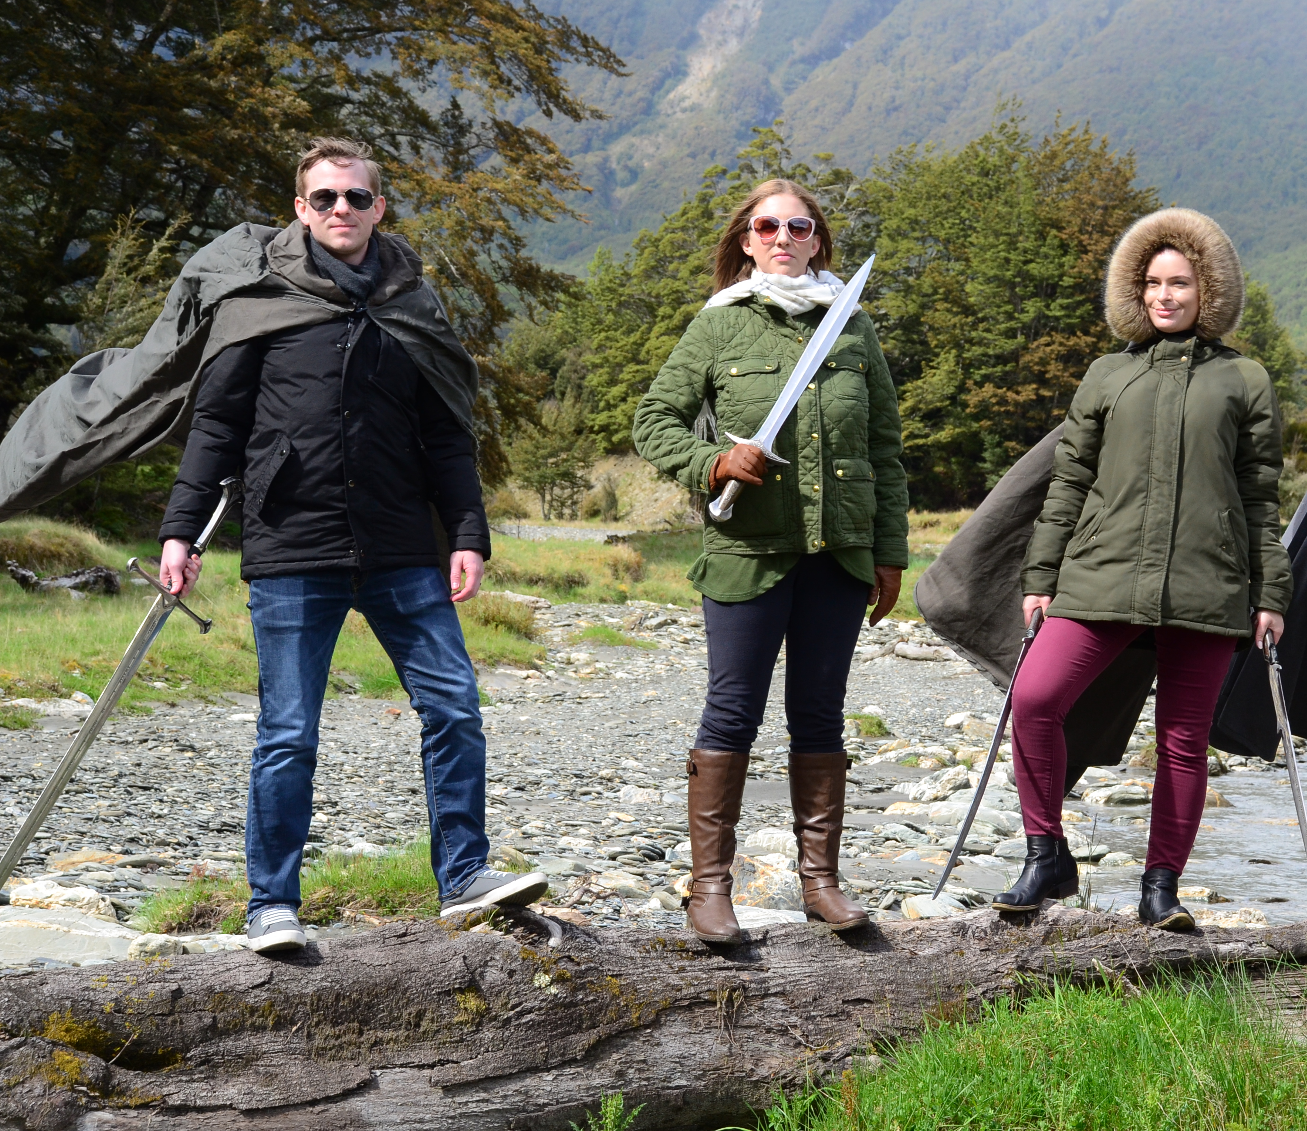

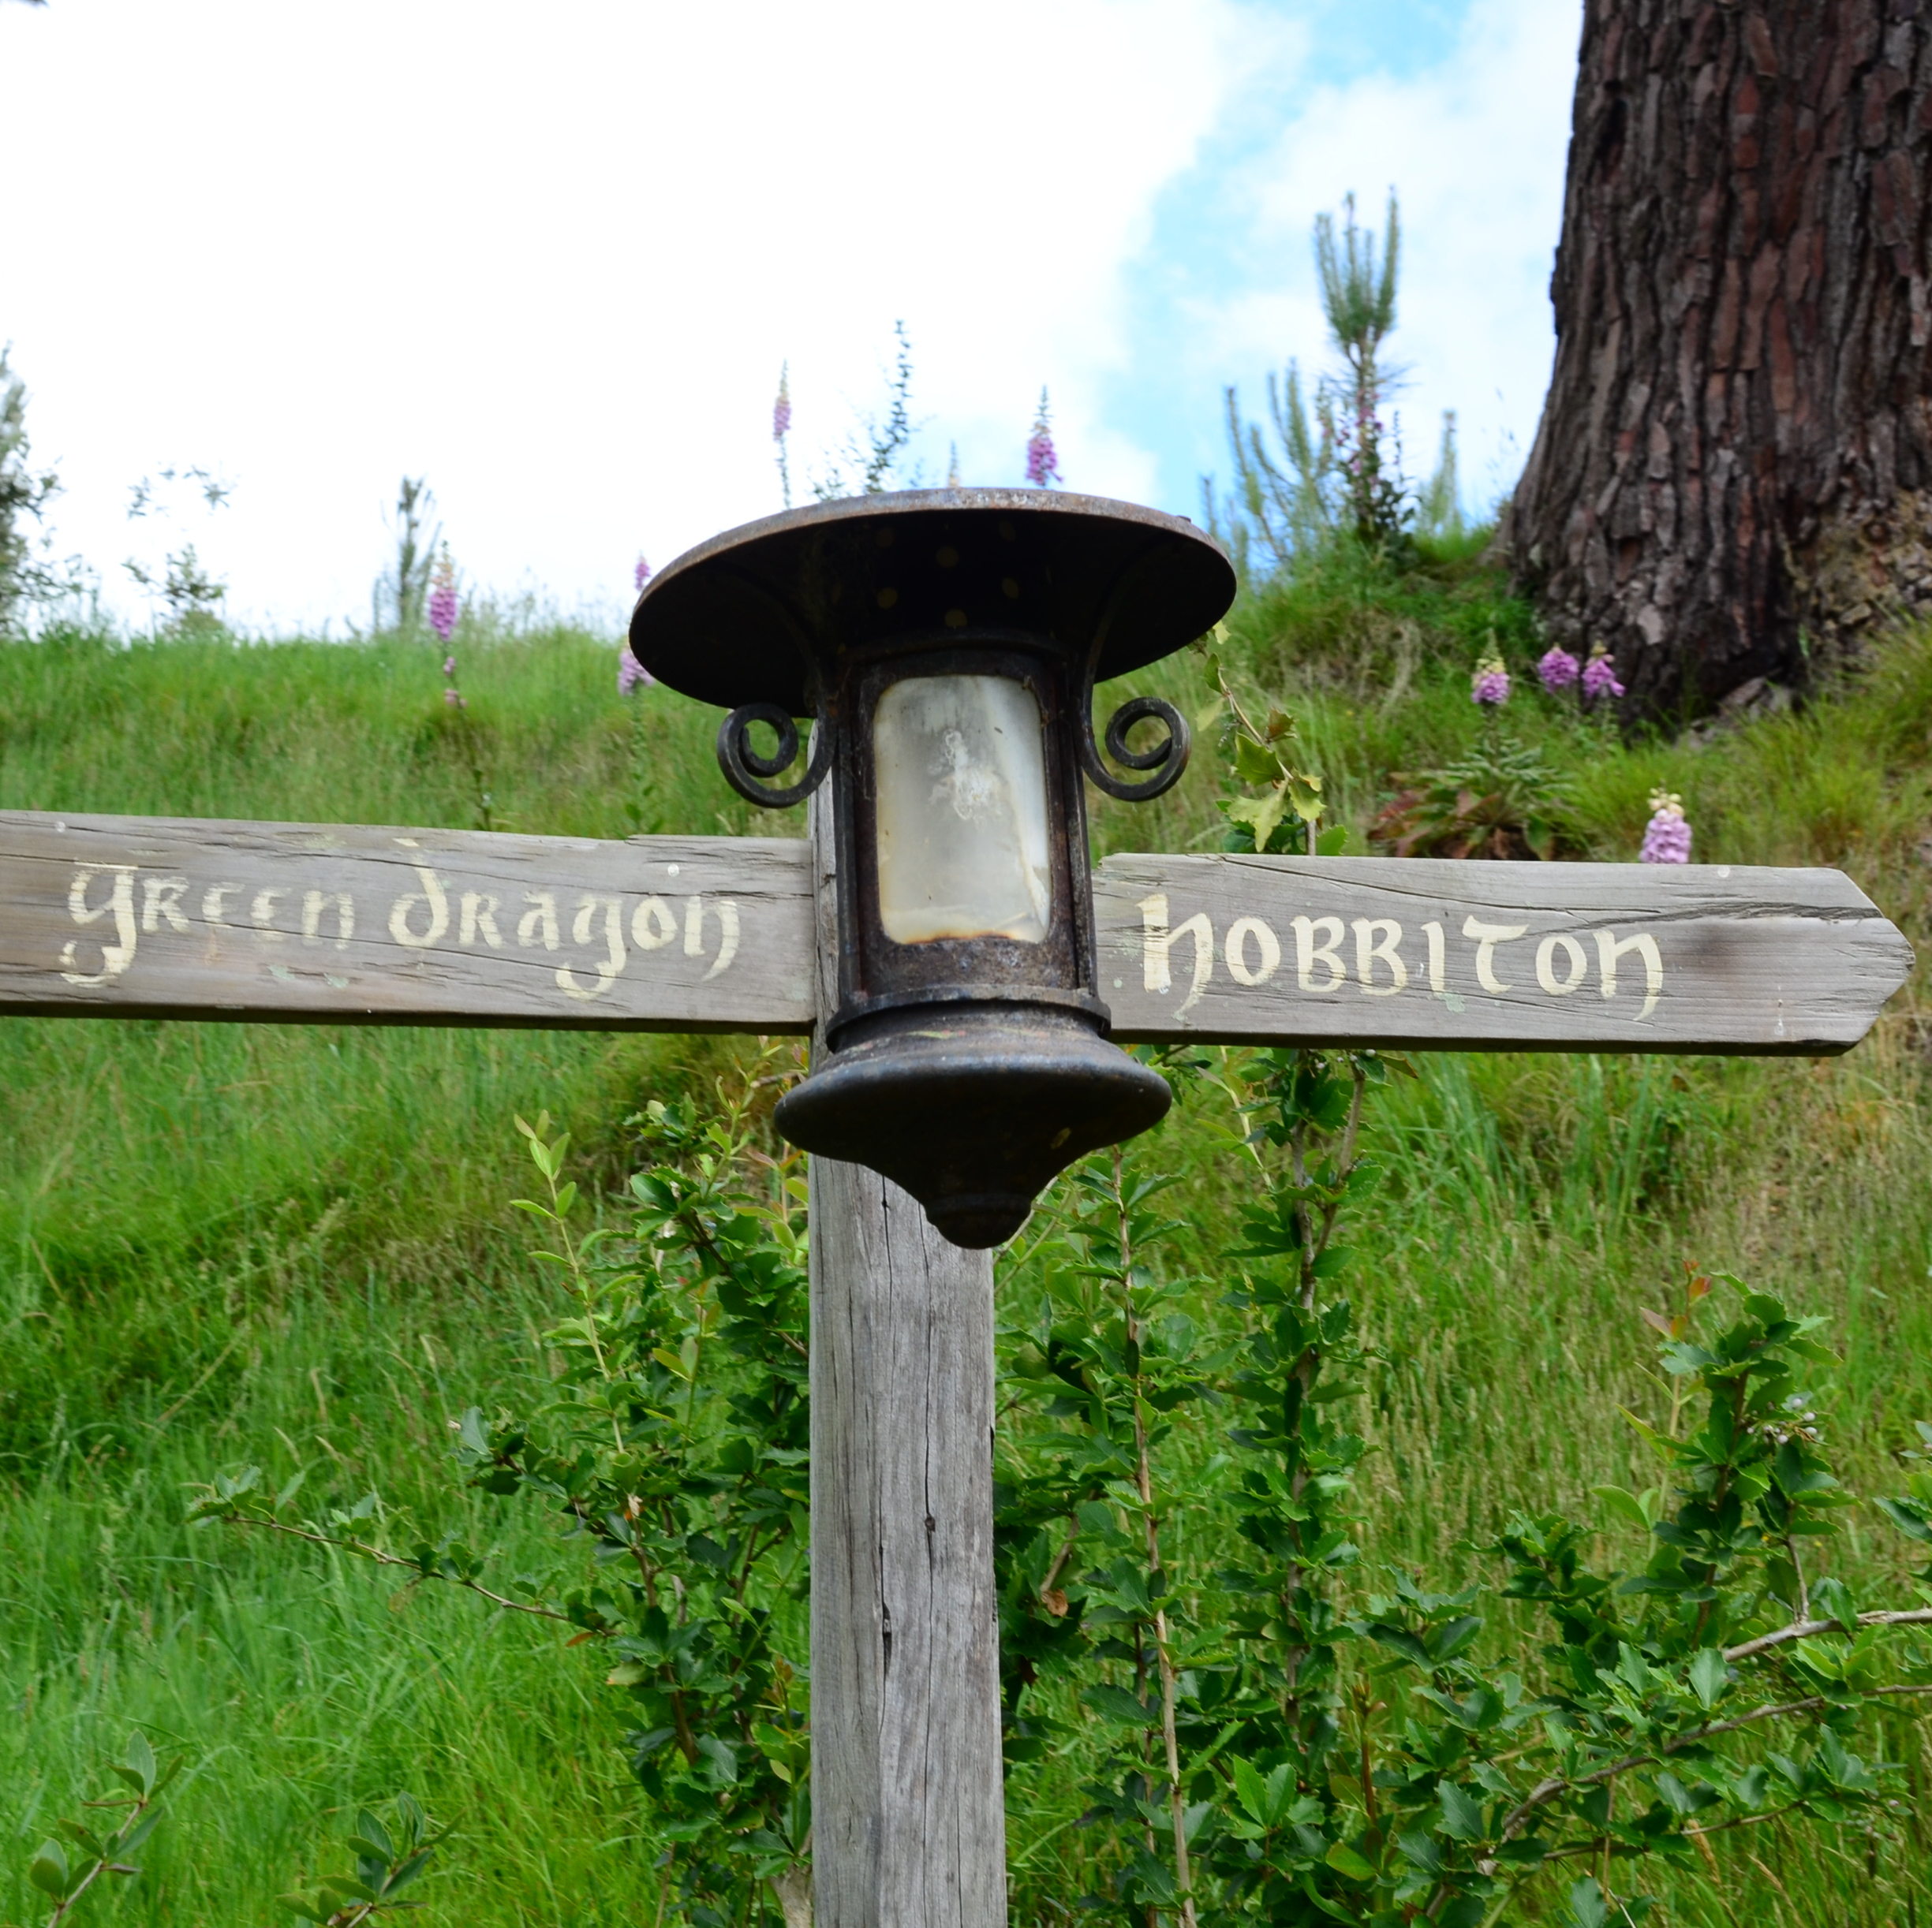
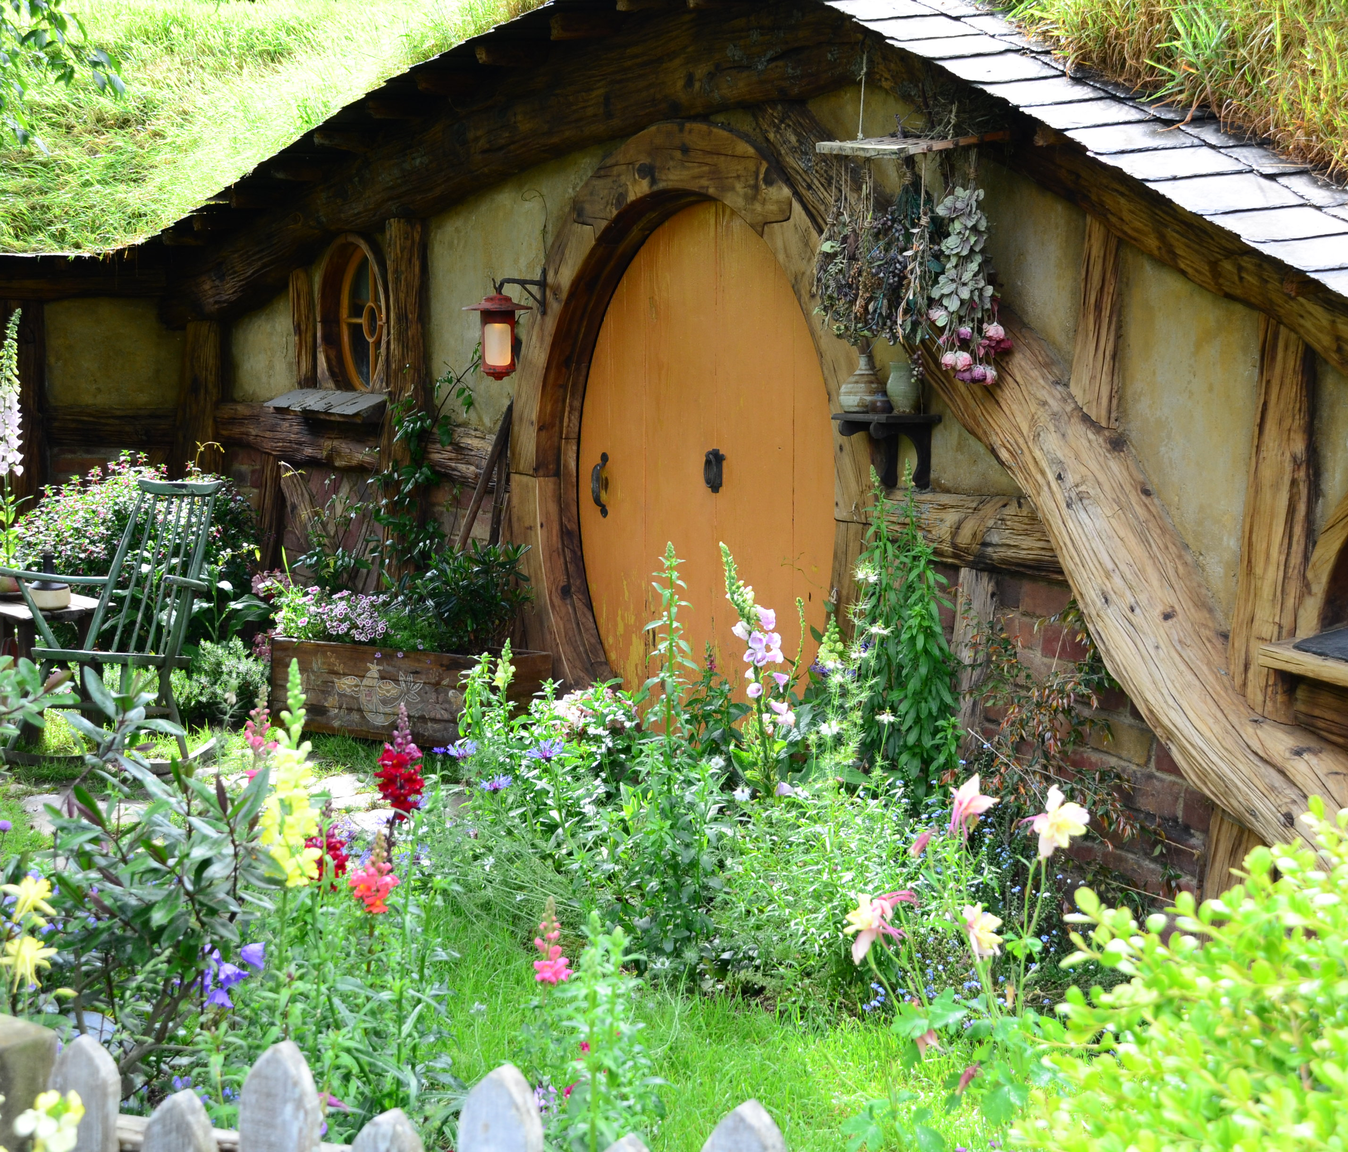
Tourist Locations
Lord of the Rings tourism
Hobbiton on the North Island
Link: Tours available

Slide 4


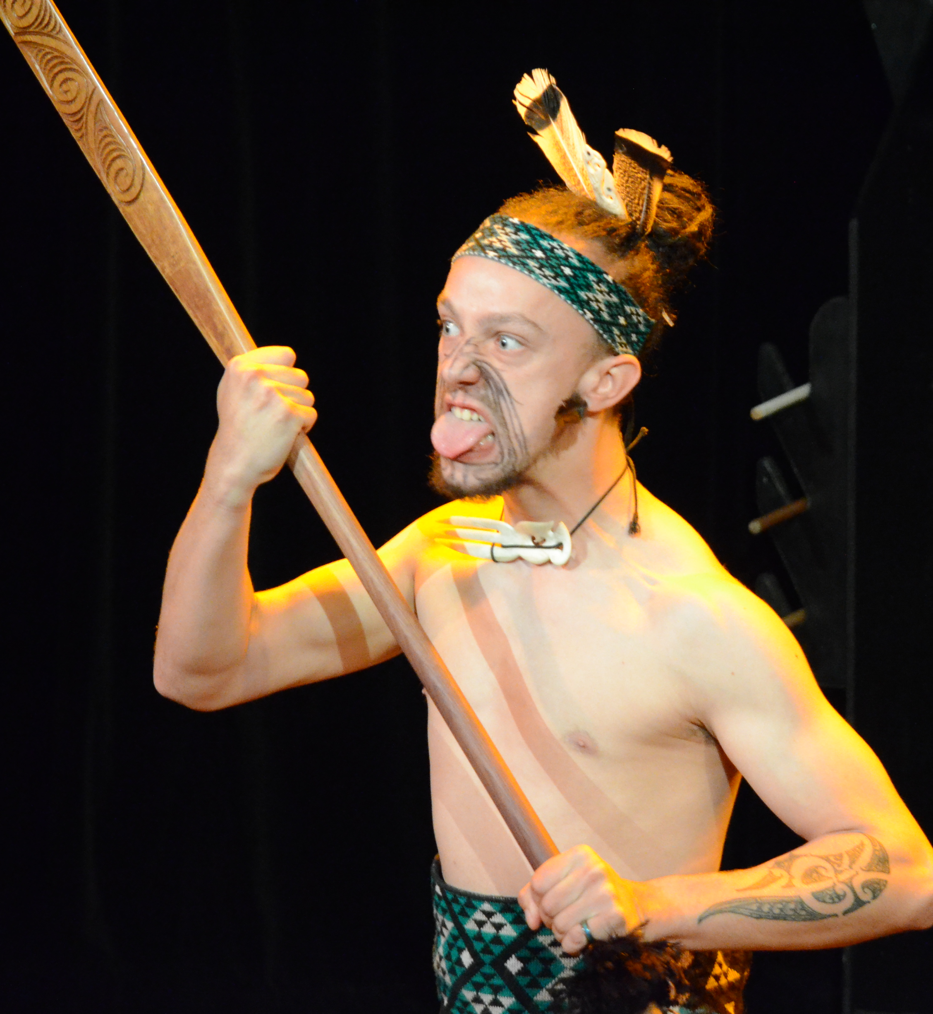
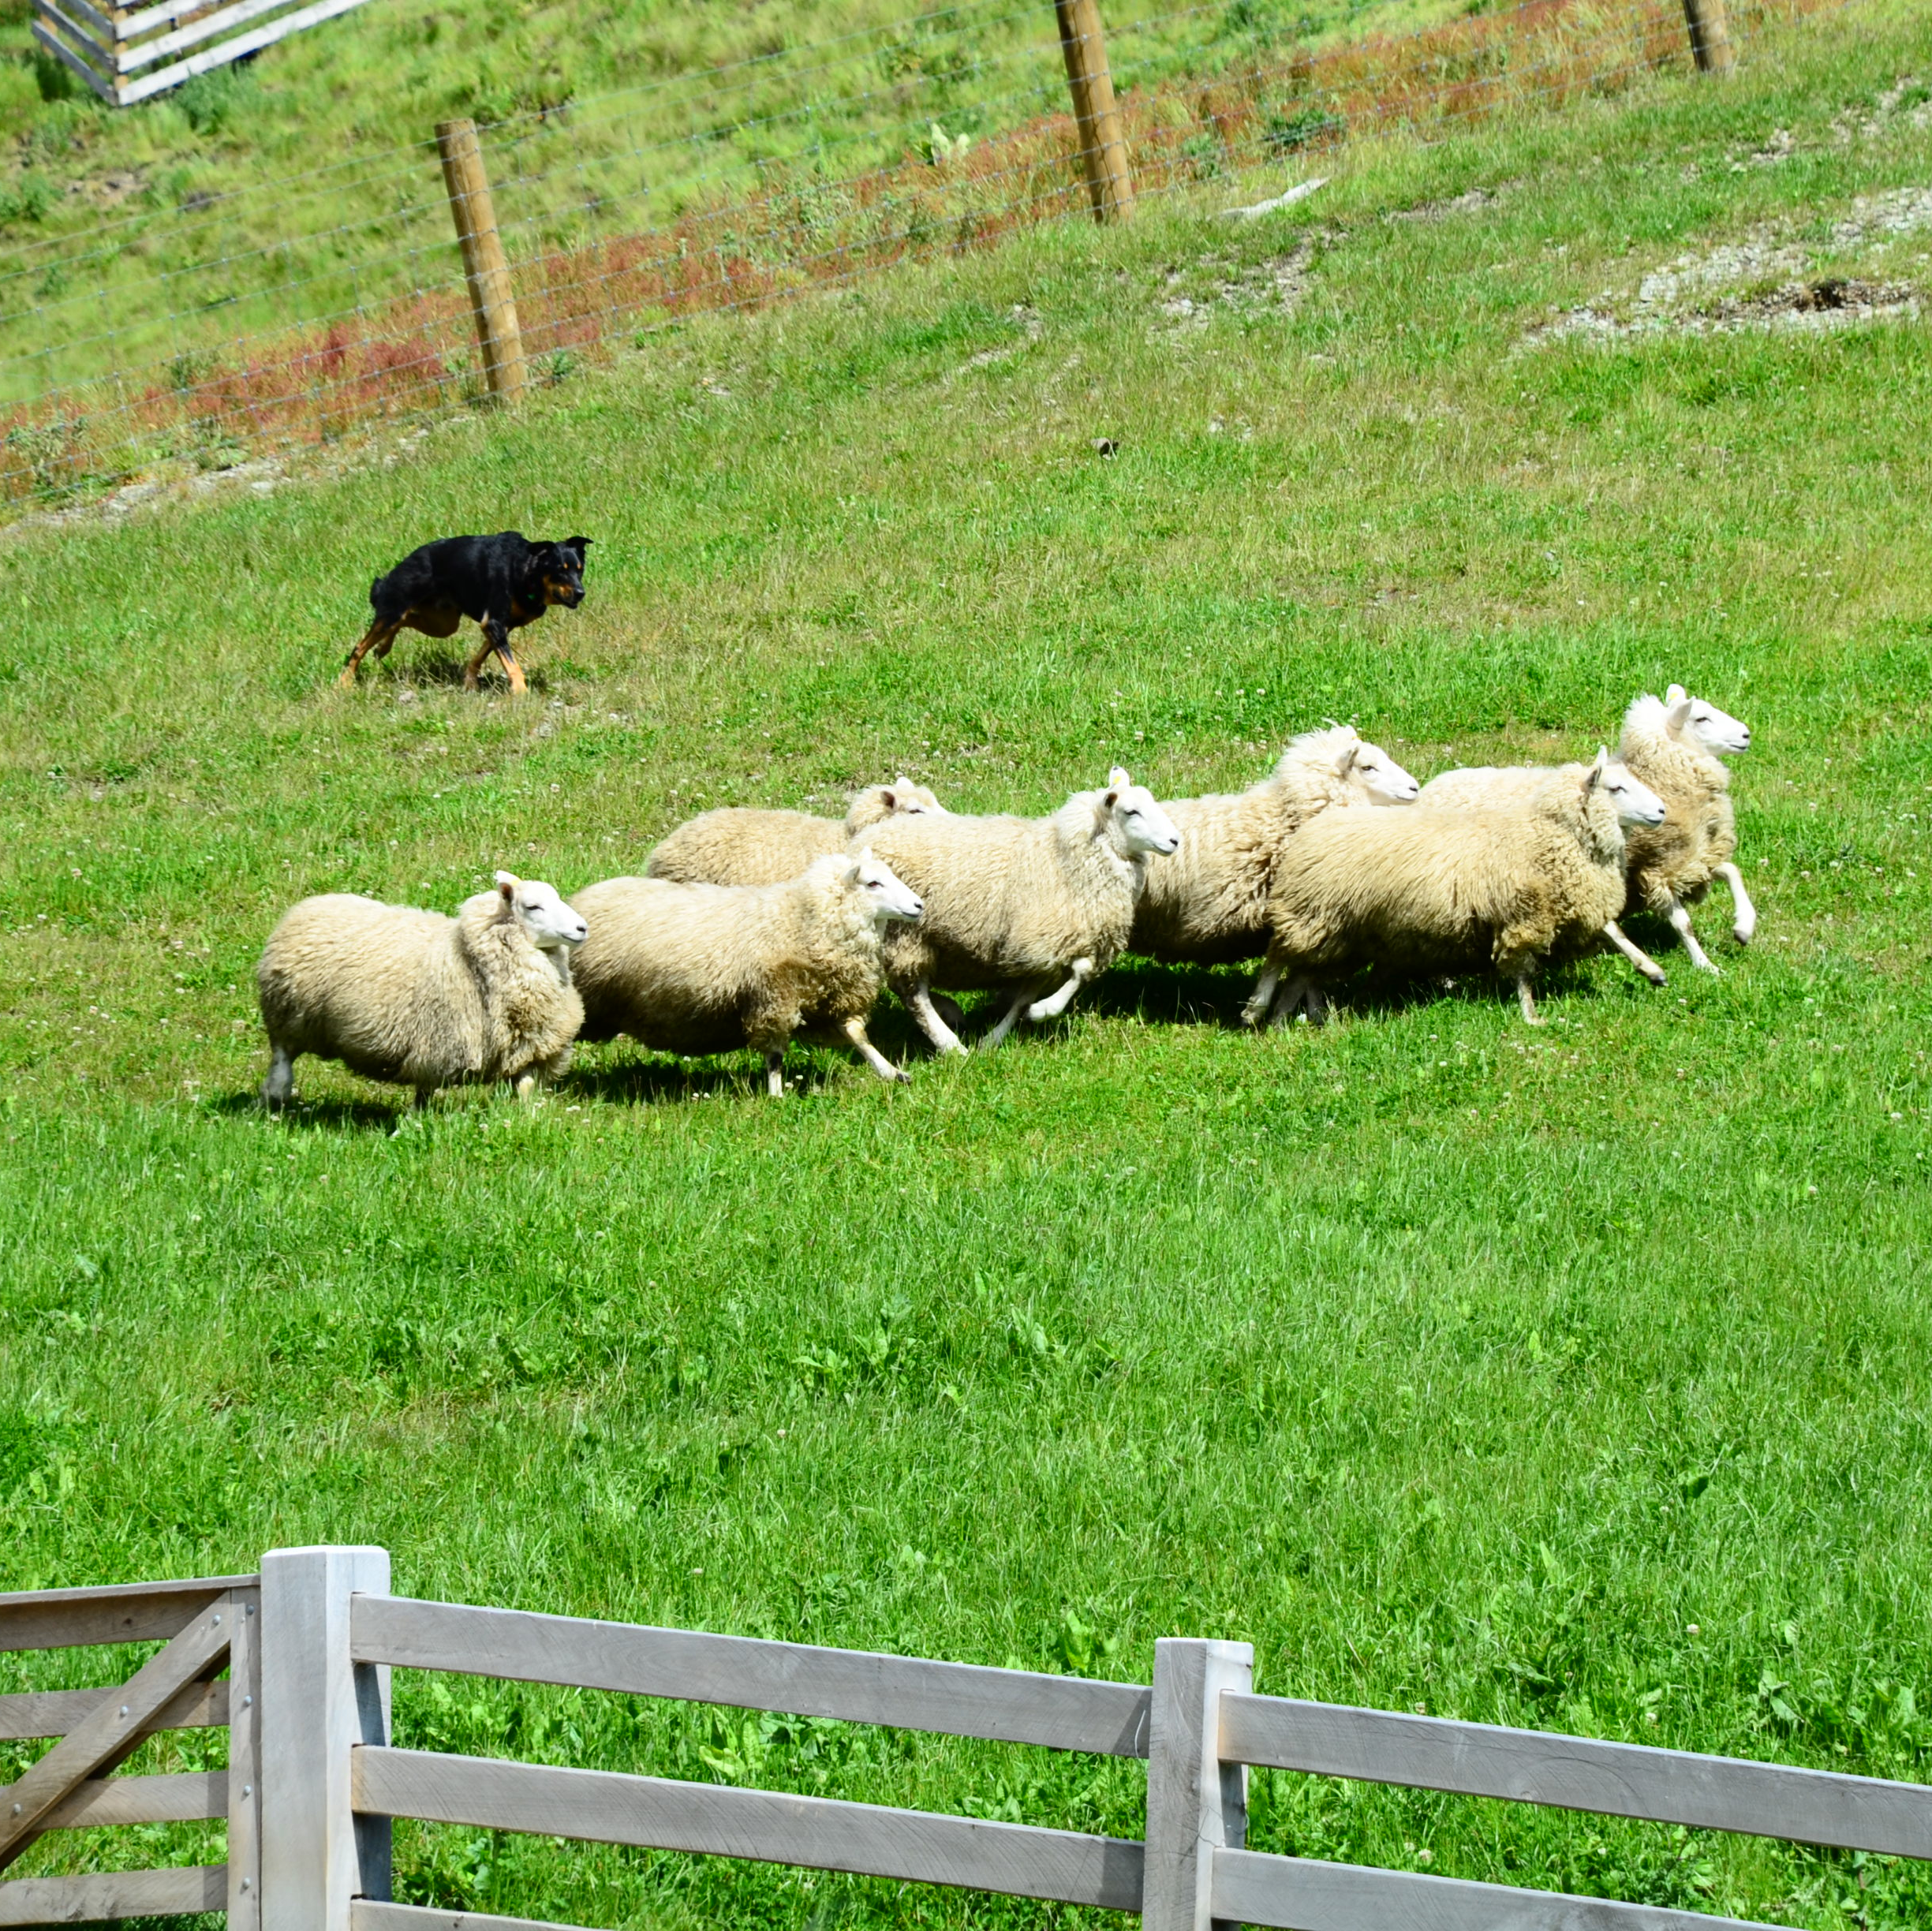
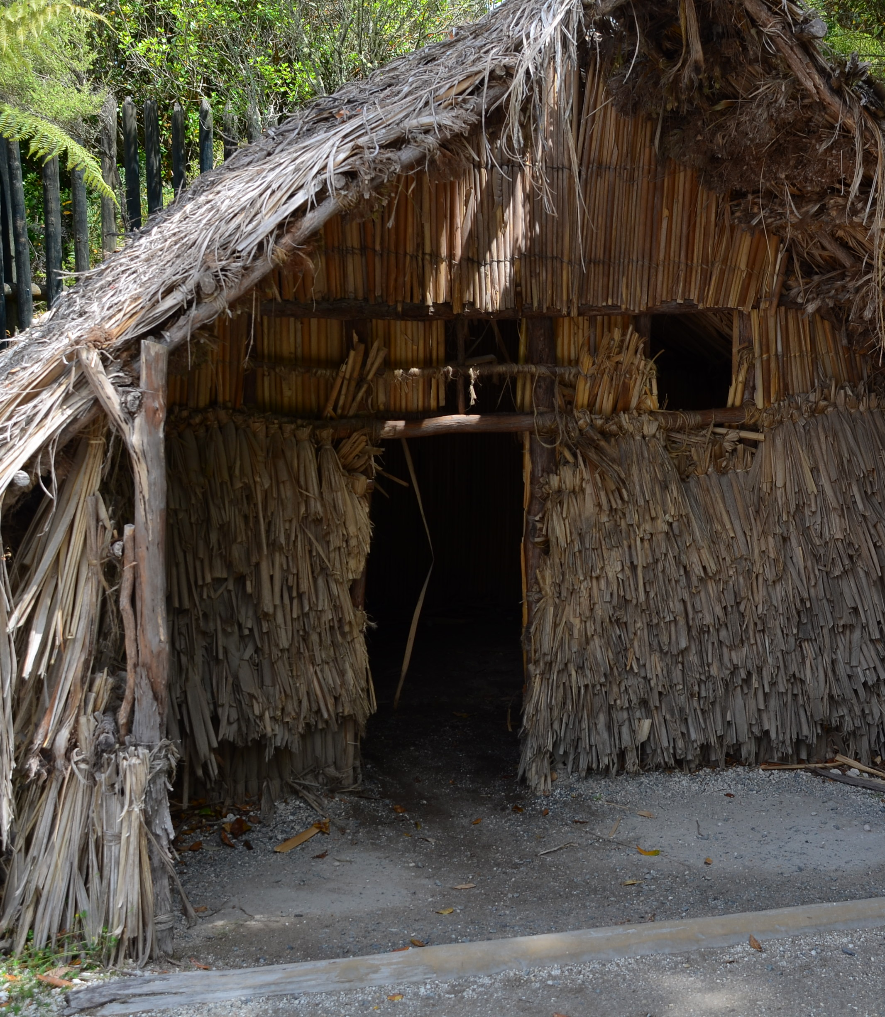
Culture
Maori are the indigenous people
Link: Performances at the Auckland Museum
Kiwis: A people, a fruit, and a bird

Slide 5

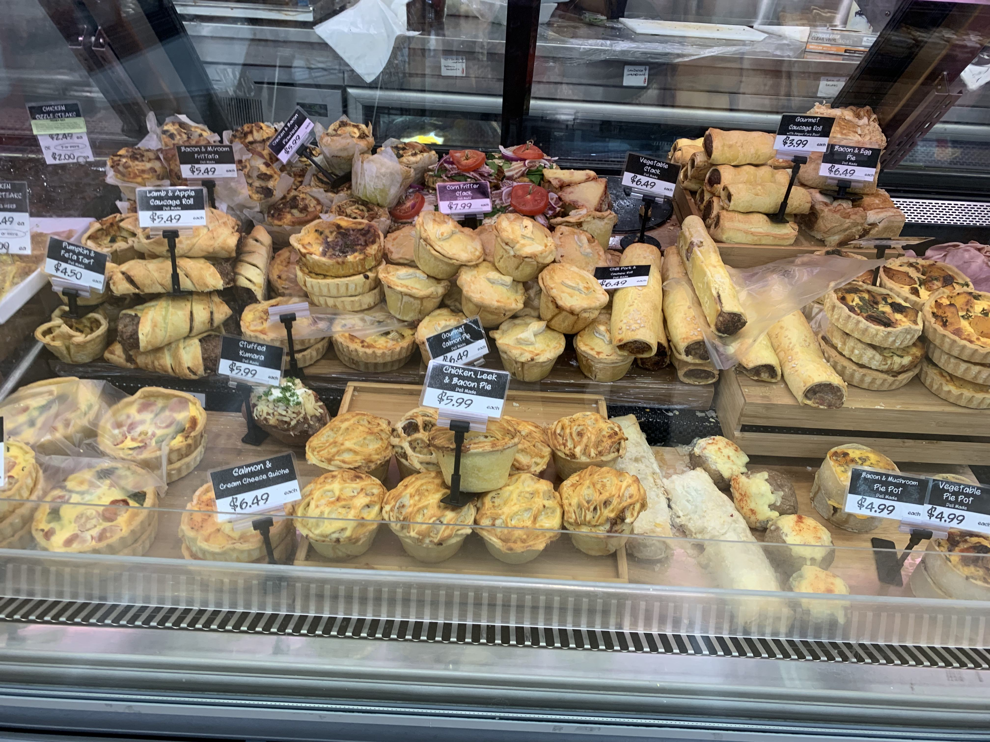
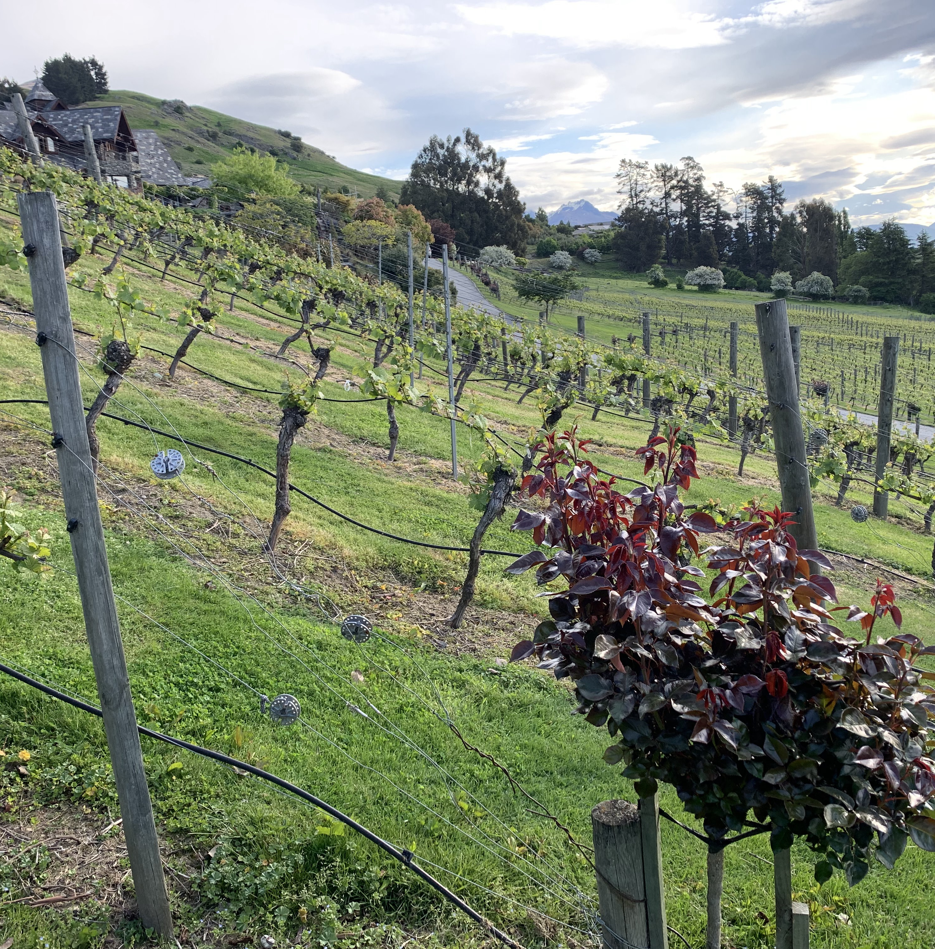
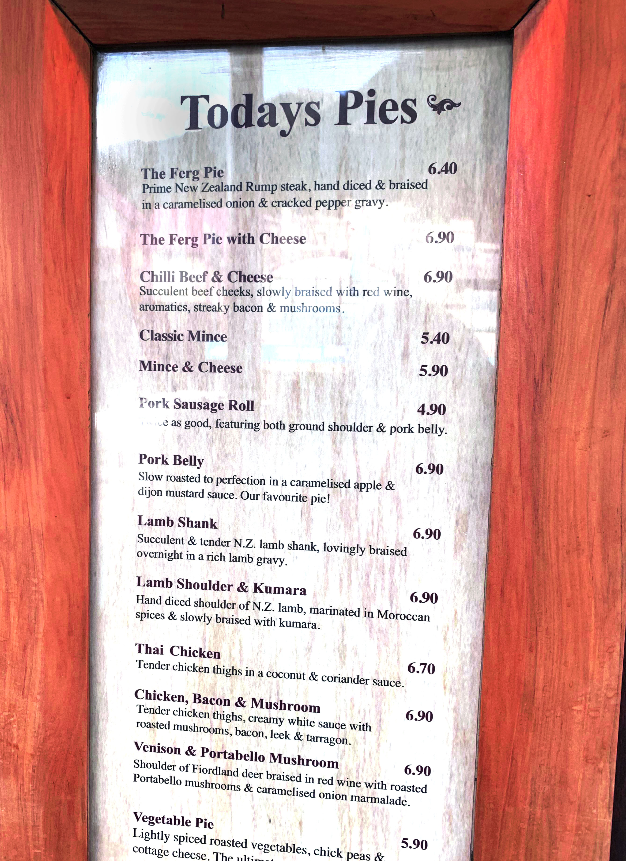
Food
Cultural hub
Lamb is a main staple
Meat based entrée pies are popular
Known for their Pinot Noir

Slide 6
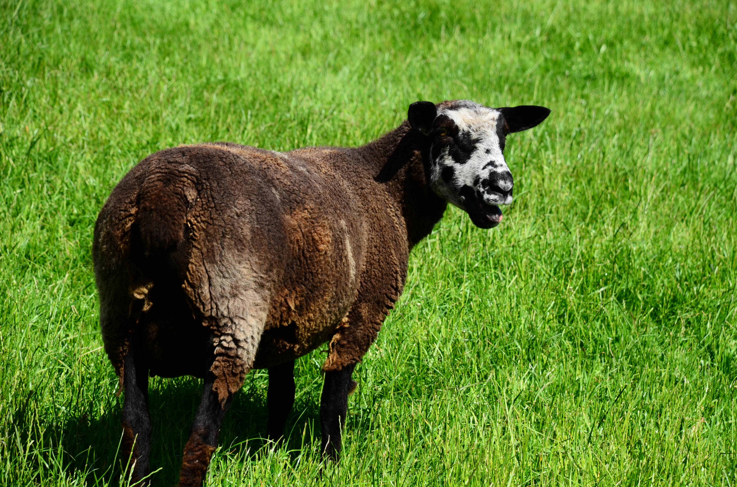
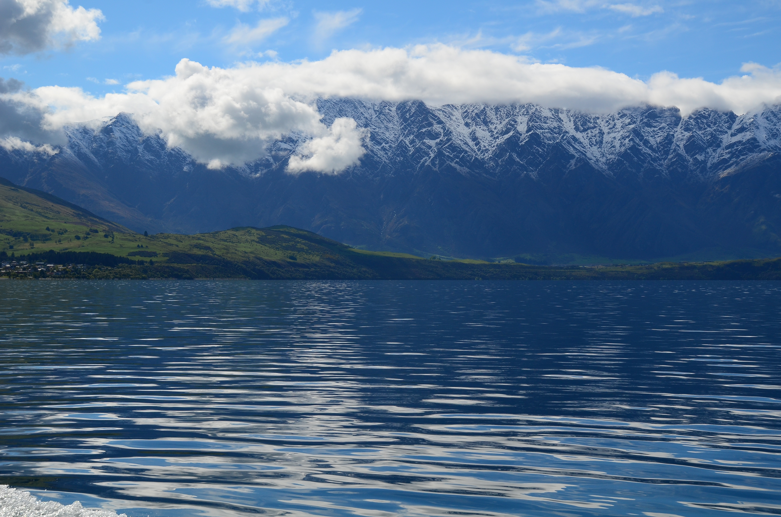
Economy
Products by most important
Industries by largest annual output
Agriculture
Industries
Dairy products and Sheep
Beef and Poultry
Fruit and Vegetables
Wine
Seafood
Wheat and Barley
Agriculture and Forestry
Fishing
Logs and wood articles
Manufacturing and Mining
Construction, Financial Services, Real Estate
Tourism

Slide 7
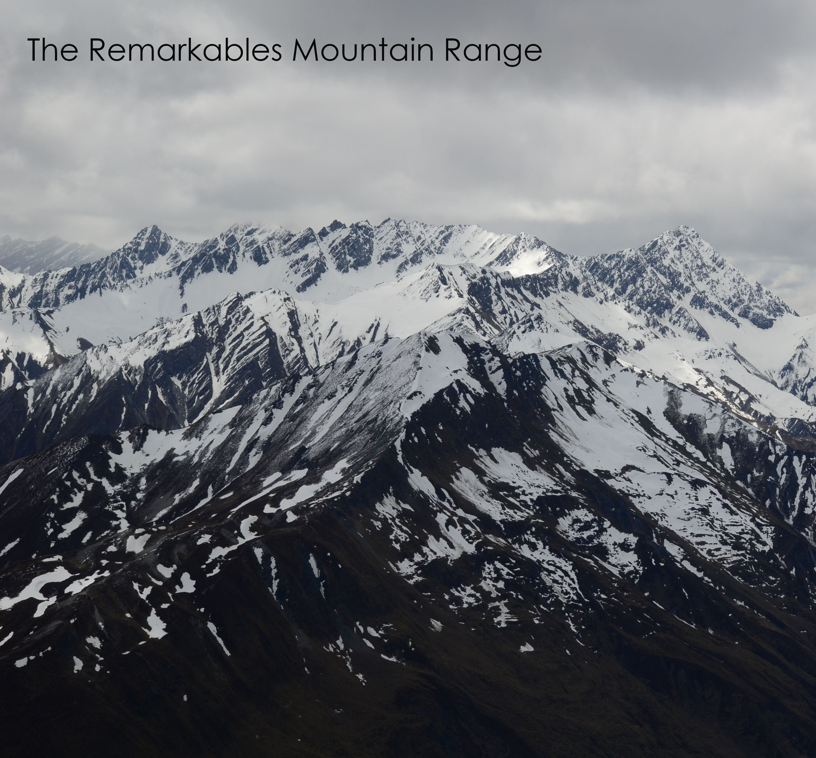
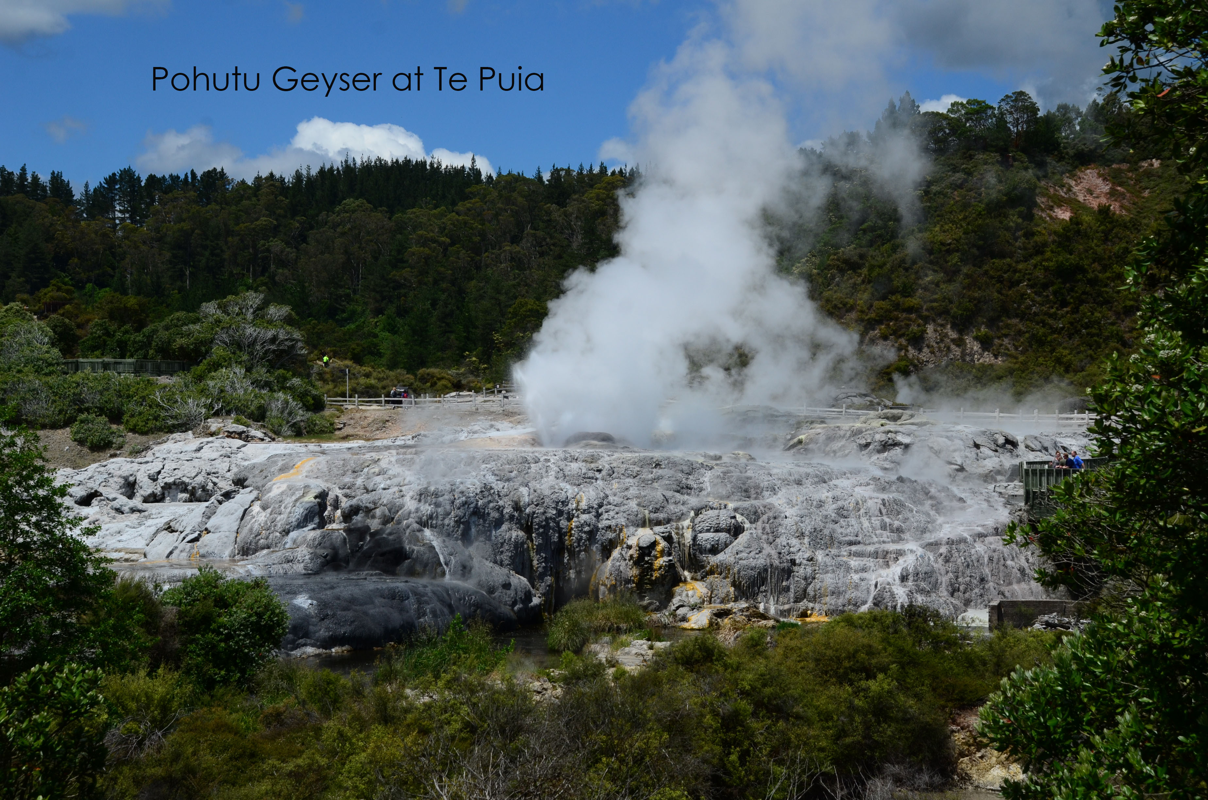
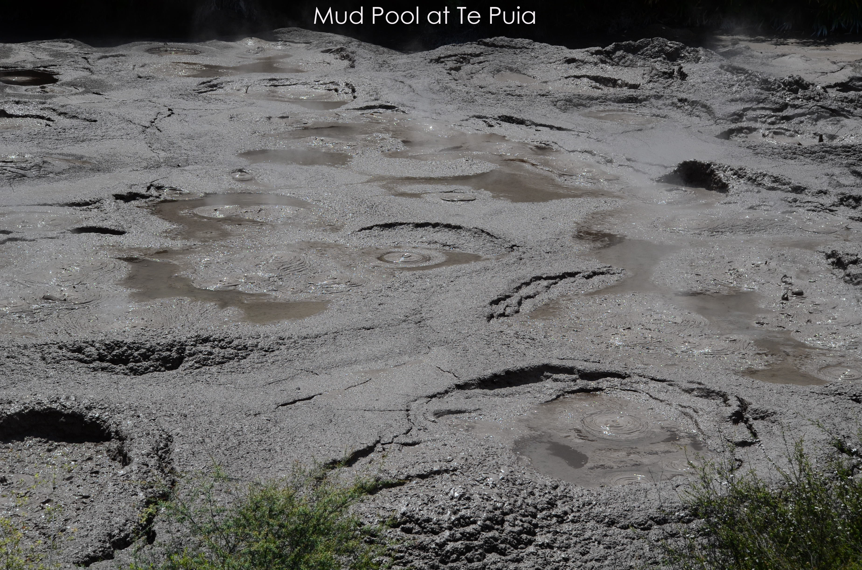

Slide 8
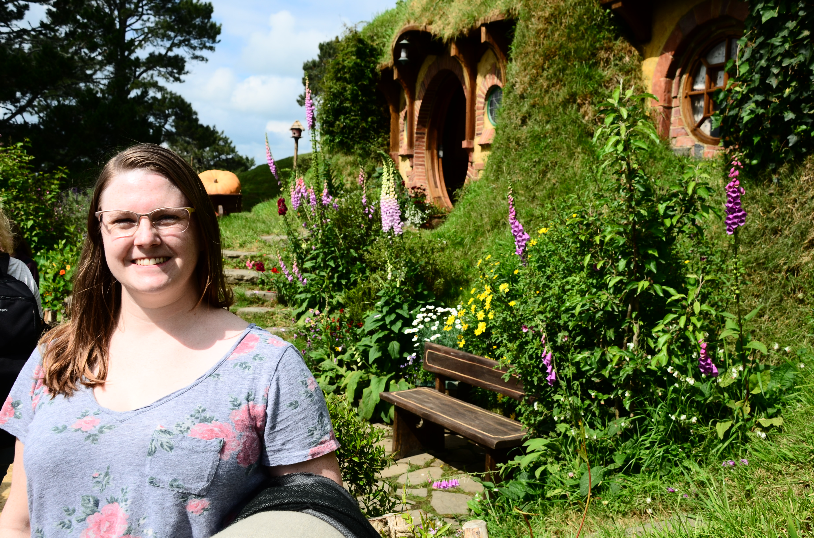
References
The World Factbook: New Zealand [Map images] [Statistical data]. (2018, February 01). Retrieved February 15, 2019, from https://www.cia.gov/library/publications/the-world-factbook/geos/nz.html
All Photos by Courtney Berkley

